Slide 1

Machine Learning & Artificial Intelligence
Shreya Raikar
Shubham Birajdar
Aryan Kumar

Slide 2
Agenda
Information Gathering
Problem Statement
Method used
Workflow created in KNIME
Results
Conclusion

Slide 3
Information Gathering
Medical records of 299 heart patients collected at Faisalabad Institute of Cardiology and Allied Hospital in Faisalabad, Punjab, Pakistan, during April–December 2015.
Consisted of women and men, aged between 40 and 95 years old.
https://www.kaggle.com/datasets/mahdifaour/heart-disease-dataset

Slide 4
Problem Statement
The objective of this analysis is to understand the factors contributing to heart disease and to develop predictive models to identify individuals at risk of developing heart disease. This will help in early diagnosis and preventive healthcare measures.

Slide 5
K-Means Clustering
Unsupervised Machine Learning Algorithm
Centroids
Distance
Cluster Assignment
Simple & efficient
Scalable

Slide 6
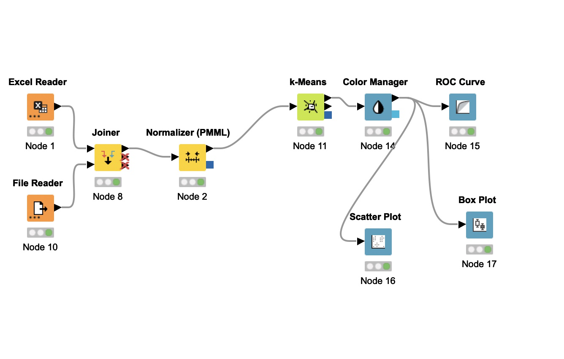
KNIME workflow

Slide 7
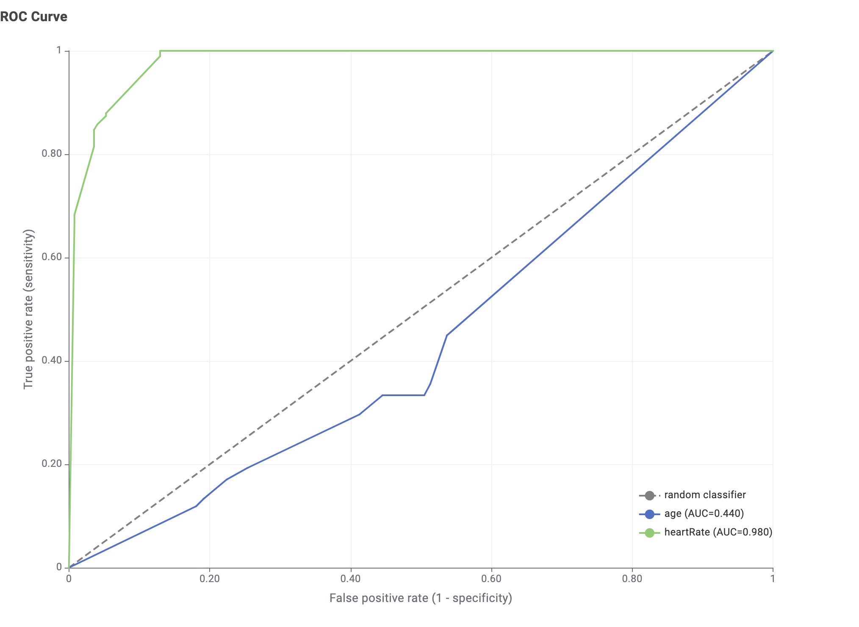
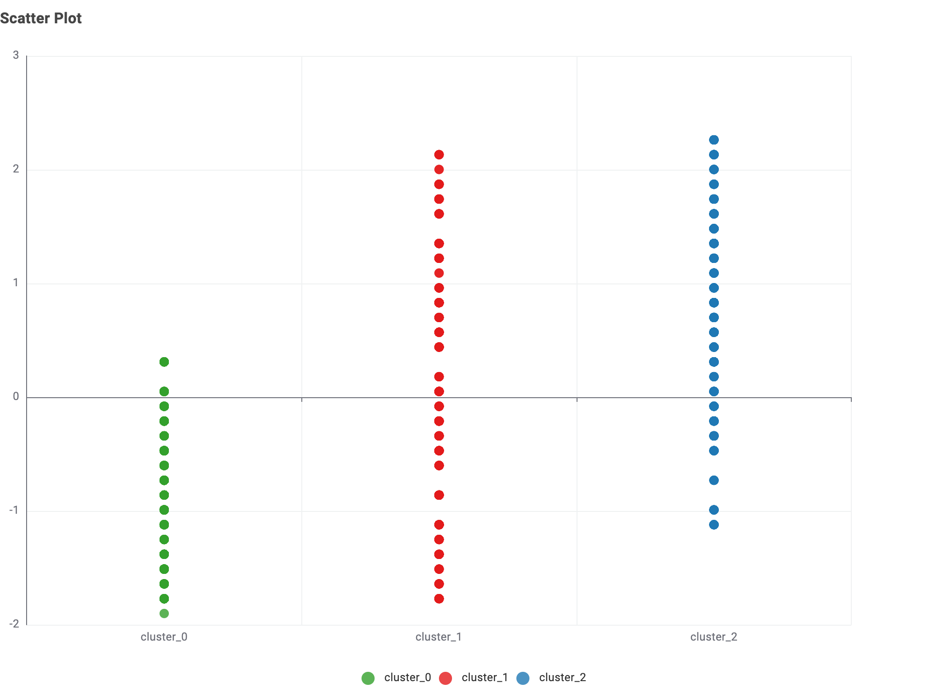
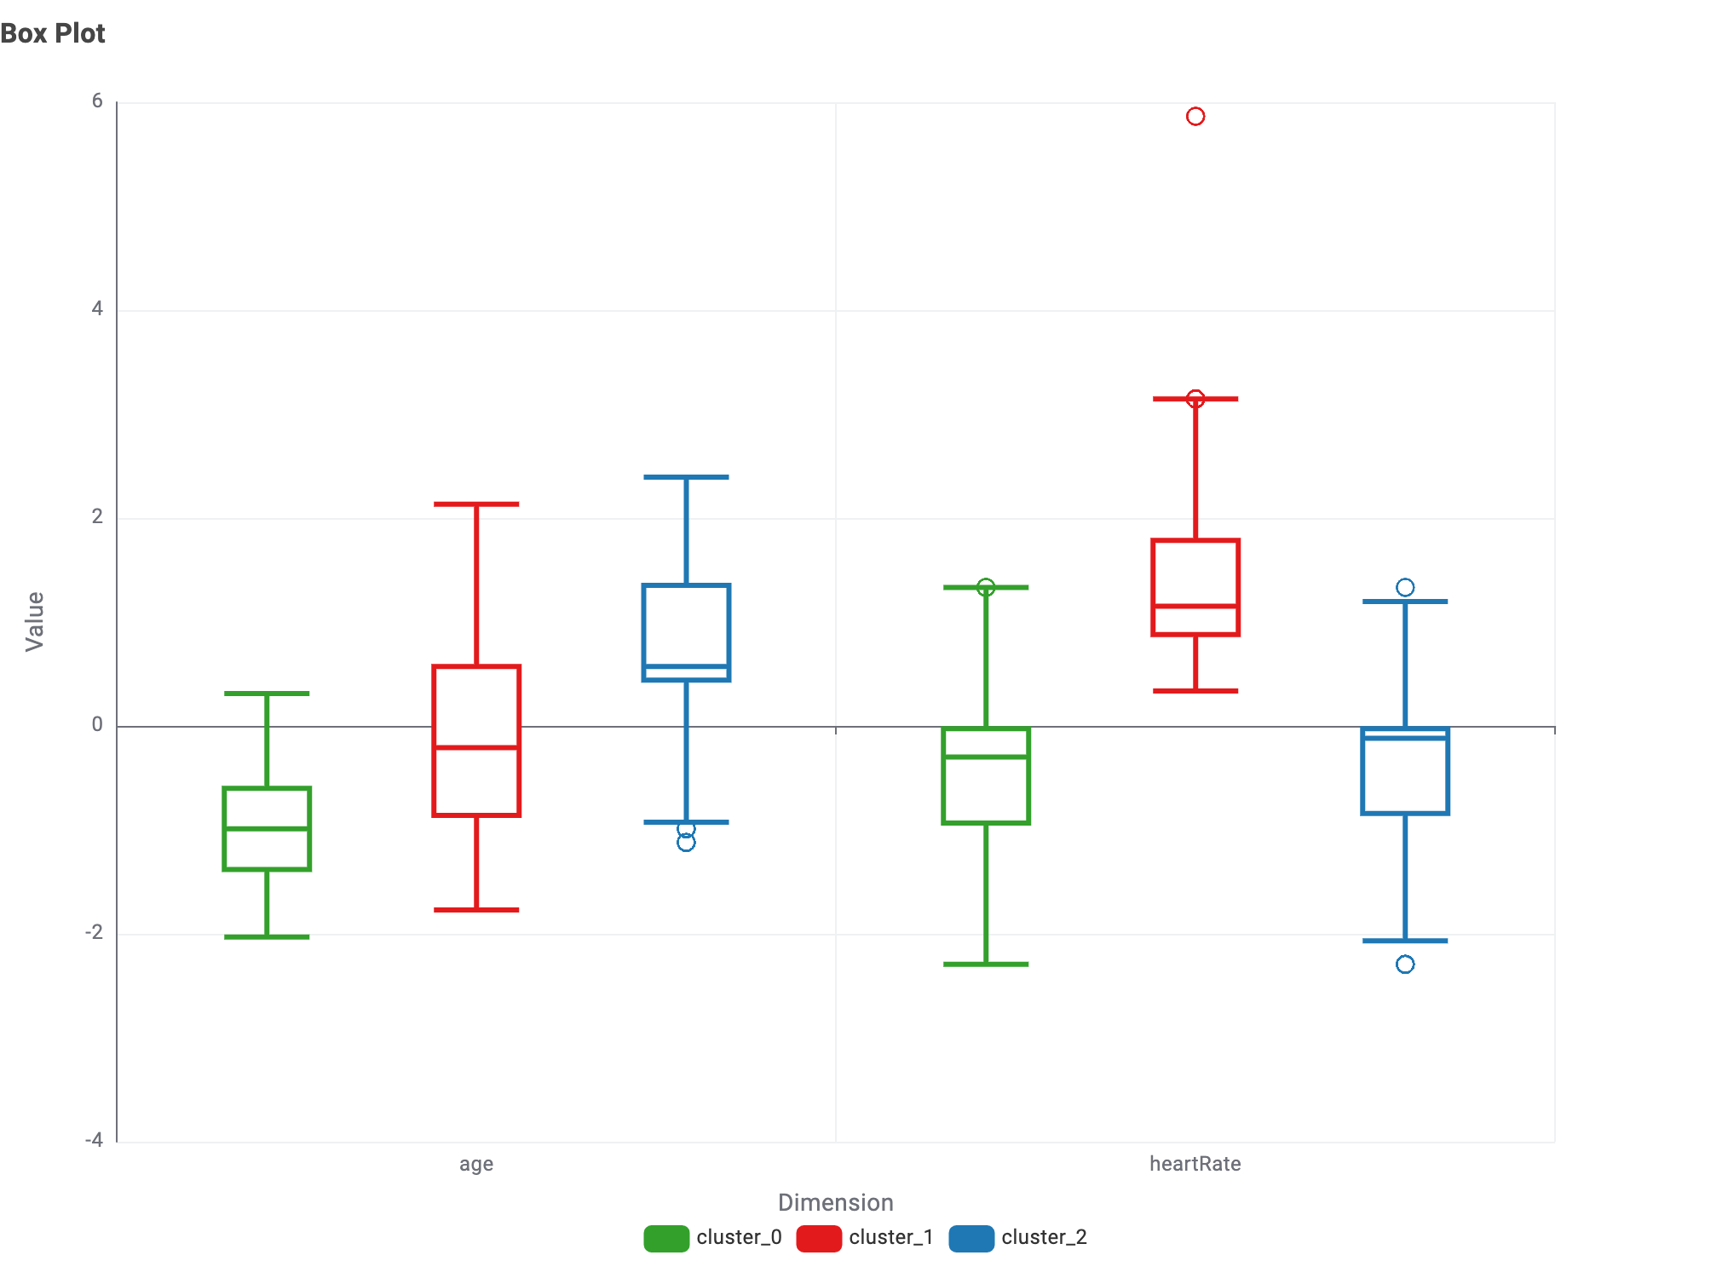

Slide 8
Conclusion
In order to conclude we would say that age and heartrate are the most important factors that result in heart diseases in different states of India. We can also view different aspects other than heart rate and age which also would play some role which would help in further and detailed diagnostics.

Slide 9
Thank You

